Slide 1
Introduction to Compiler Construction
- Compiler Design

Slide 2
Objectives
Be able to build a compiler for a (simplified) (programming) language
Know how to use compiler construction tools, such as generators of scanners and parsers
Be familiar with different phses of Compiler
Be able to define LL(1), LR(1), and LALR(1) grammars
Be familiar with compiler analysis and optimization techniques
Learn how to work on a larger software project!
Understand and implement cross compiler.

Slide 3
Compilers
“Compilation”
  Translation of a program written in a source language into a semantically equivalent program written in a target language
Input
Source
Program
Compiler
Target
Program
Error messages
Output

Slide 4
Features of Compilers
Speed of compilation
Preserve the correct the meaning of the code
The speed of the target code
Recognize legal and illegal program constructs
Good error reporting/handling
Code debugging help

Slide 5
Compilers and Interpreters (cont’d)
“Interpretation”
  Performing the operations implied by the source program
Source
Program
Interpreter
Output
Input
Error messages

Slide 6
Types of Compiler
Single Pass Compilers
Two Pass Compilers
Multipass Compilers

Slide 7
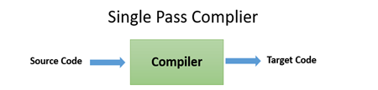
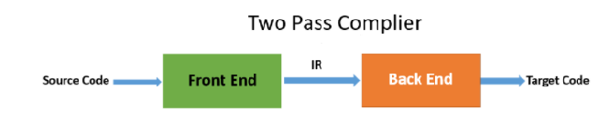
Types of Compiler

Slide 8
The Grouping of Phases
Compiler passes:
  A collection of phases is done only once (single pass) or multiple times (multi pass)
    Single pass: usually requires everything to be defined before being used in source program
    Multi pass: compiler may have to keep entire program representation in memory

Slide 9
Traditional three pass compiler
Source
code
Front end
IR
Middle
end
IR
Back end
Machine
code
errors
'Wide Compiler’-less memory
Code improvement analyzes and change IR
Goal is to reduce runtime
Source-to-source Compiler(Jython)

Slide 10
The Analysis-Synthesis Model of Compilation
There are two parts to compilation:
  Analysis determines the operations implied by the source program which are recorded in a tree structure
  Synthesis takes the tree structure and translates the operations therein into the target program

Slide 11
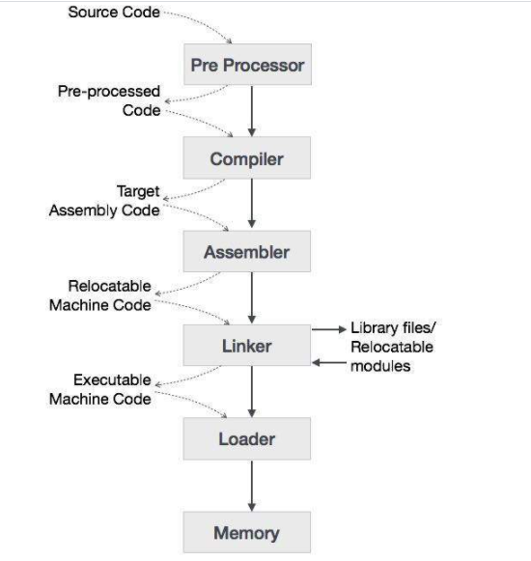
Language Processing System

Slide 12
Preprocessors, Compilers, Assemblers, and Linkers
Skeletal Source Program
Preprocessor
Source Program
Compiler
Try for example:
gcc -v myprog.c
Target Assembly Program
Assembler
Relocatable Object Code
Linker
Libraries and
Relocatable Object Files
Absolute Machine Code
Loader

Slide 13
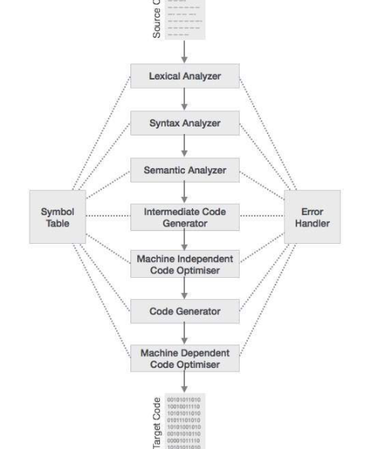

Slide 14
Compiler Phases
Breaks up the source program into pieces and impose grammatical structure on them
Allows to construct the desired target program i.e.IR and also create the symbol table
Compiles source code and detects errors in it
Manage storage of all variables and codes.
Support for separate compilation
Read, analyze the entire program, and translate to semantically equivalent
Translating the source code into object code depending upon the type of machine

Slide 15
The Phases of a Compiler
Phase | Output | Sample
Programmer (source code producer) | Source string | A=B+C;
Scanner (performs lexical analysis) | Token string | ‘A’, ‘=’, ‘B’, ‘+’, ‘C’, ‘;’ And symbol table with names
Parser (performs syntax analysis based on the grammar of the programming language) | Parse tree or abstract syntax tree | ; | = / \ A + / \ B C
Semantic analyzer (type checking, etc) | Annotated parse tree or abstract syntax tree
Intermediate code generator | Three-address code, quads, or RTL | int2fp B t1 + t1 C t2 := t2 A
Optimizer | Three-address code, quads, or RTL | int2fp B t1 + t1 #2.3 A
Code generator | Assembly code | MOVF #2.3,r1 ADDF2 r1,r2 MOVF r2,A
Peephole optimizer | Assembly code | ADDF2 #2.3,r2 MOVF r2,A

Slide 16
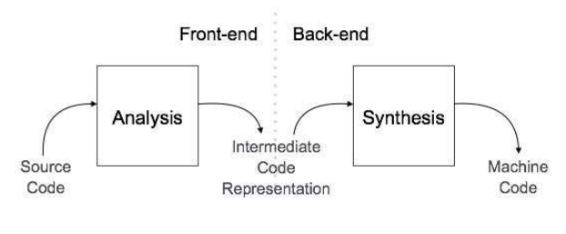
Compiler Phases
Recognizes legal (and illegal) programs
Generate correct code
Manage storage of all variables and code
Agreement on format for object (or assembly) code

Slide 17
Front-end
Source
code
Front end
IR
Back end
Machine
code
errors
Front end maps legal code into IR
Back end maps IR onto target machine
Simplify retargeting
Report errors
Allows multiple front ends
Multiple passes -> better code

Slide 18
Front end
Source
code
Scanner
tokens
Parser
IR
errors
Scanner:
  Maps characters into tokens – the basic unit of syntax
    x = x + y becomes <id, x> = <id, x> + <id, y>
  Typical tokens: number, id, +, -, *, /, do, end
  Eliminate white space (tabs, blanks, comments)
A key issue is speed so instead of using a tool like LEX it sometimes needed to write your own scanner

Slide 19
Front end
Source
code
Scanner
tokens
Parser
IR
errors
Parser:
  Recognize context-free syntax
  Guide context-sensitive analysis
  Construct IR
  Produce meaningful error messages
  Attempt error correction
There are parser generators like YACC which automates much of the work

Slide 20
Front end
Store type information gathered and save it in symbol table or syntax tree
Allows to perform type checking
In the case of type mismatch, desired operation a semantic error is shown
Collects type information and checks for type compatibility
Checks if the source language permits the operands or no
Context free grammars are used to represent programming language syntaxes:
<expr> ::= <expr> <op> <term> | <term>
<term> ::= <number> | <id>
<op> ::= + | -

Slide 21
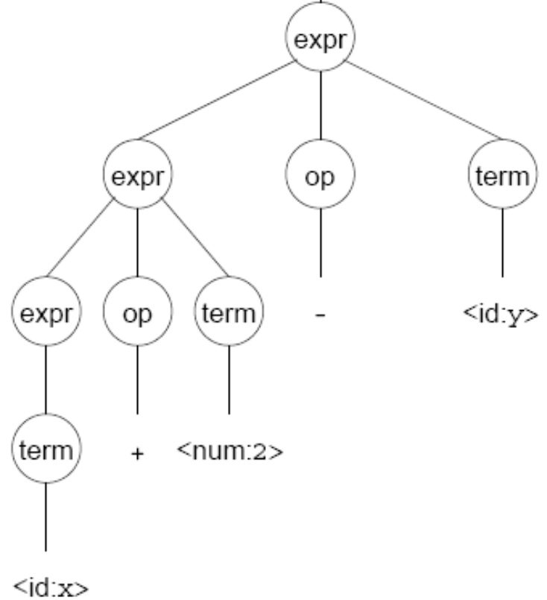
Front end
A parser tries to map a program to the syntactic elements defined in the grammar
A parse can be represented by a tree called a parse or syntax tree

Slide 22
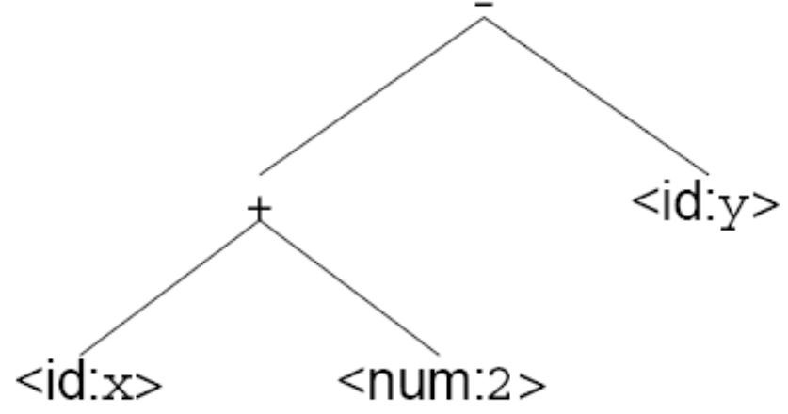
Front end
A parse tree can be represented more compactly referred to as Abstract Syntax Tree (AST)
AST is often used as IR between front end and back end

Slide 23
Back end
Instruction
selection
Register
Allocation
Machine code
IR
errors
Translate IR into target machine code
Choose instructions for each IR operation
Decide what to keep in registers at each point
Ensure conformance with system interfaces
Produce compact fast code
Use available addressing modes
Have a value in a register when used

Slide 24
Middle end (optimizer)
Modern optimizers are usually built as a set of passes
Typical passes
  Constant propagation
  Common sub-expression elimination
  Redundant store elimination
  Dead code elimination

Slide 25
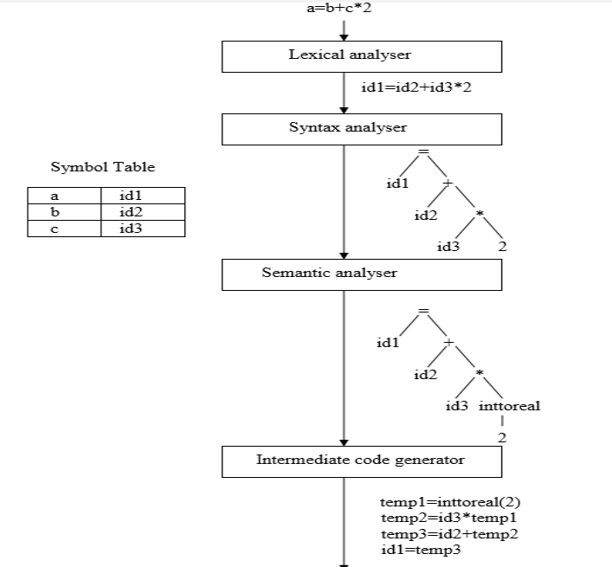

Slide 26
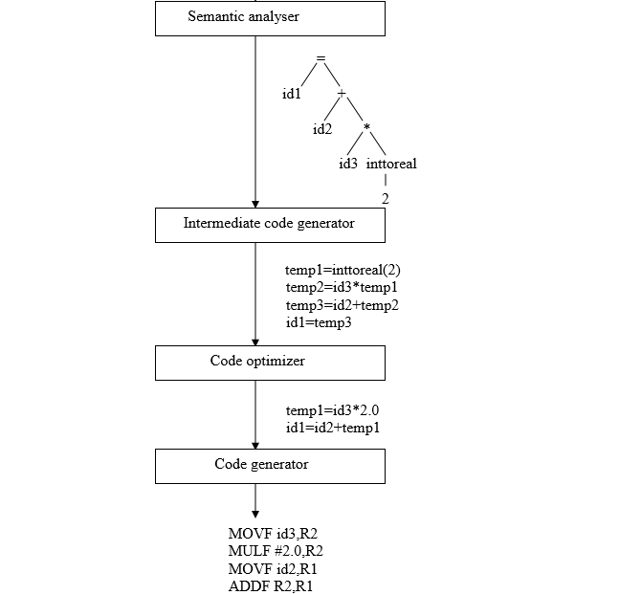

Slide 27
Tokens, Patterns, and Lexemes
A token is a classification of lexical units
  For example: id and num
Lexemes are the specific character strings that make up a token
  For example: abc and 123
Patterns are rules describing the set of lexemes belonging to a token
  For example: “letter followed by letters and digits” and “non-empty sequence of digits”

Slide 28
Specification of Patterns for Tokens: Definitions
An alphabet Σ is a finite set of symbols (characters)
A string s is a finite sequence of symbols from Σ
  ⏐s⏐ denotes the length of string s
  ε denotes the empty string, thus ⏐ε⏐ = 0
A language is a specific set of strings over some fixed alphabet Σ
DFA as recognizer to Regular Expression
Context free grammar

Slide 29
Attributes of Tokens
Lexical analyzer
y := 31 + 28*x
<id, “y”> <assign, > <num, 31> <‘+’, > <num, 28> <‘*’, > <id, “x”>
token
(lookahead)
Parser
tokenval
(token attribute)

Slide 30
Example of generating Tokens
For example, in C language, the variable declaration line
Longest Match Rule
rule priority
int value = 100;
contains the tokens:
int (keyword), value (identifier), = (operator), 100 (constant) and ; (symbol).

Slide 31
Compiler-Construction Tools
Software development tools are available to implement one or more compiler phases
  Scanner generators
  Parser generators
  Syntax-directed translation engines
  Automatic code generators
  Data-flow engines

Slide 32
Other Tools that Use the Analysis-Synthesis Model
Editors (syntax highlighting)
Pretty printers (e.g. Doxygen)
Static checkers (e.g. Lint and Splint)
Interpreters
Text formatters (e.g. TeX and LaTeX)
Silicon compilers (e.g. VHDL)
Query interpreters/compilers (Databases)

Slide 33
Outline
Ch. 1: Introduction
Ch. 2: A simple One-Pass Compiler for the JVM
Ch. 3: Lexical Analysis and Lex/Flex
Ch. 4: Syntax Analysis and Yacc/Bison
Ch. 5: Syntax-Directed Translation
Ch. 6: Type Checking
Ch. 7: Run-Time Environments
Ch. 8: Intermediate Code Generation
Ch. 9: Code Generation
Ch.10: Code Optimization

